Slide 1
Special Operators

Slide 2
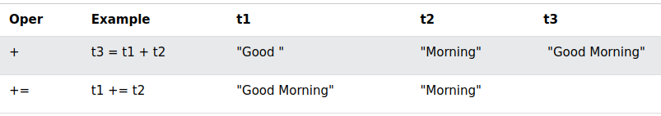
String Operators
The + operator, and the += operator can also be used to concatenate (add) strings.
Given that t1 = "Good ", t2 = "Morning", and t3 = "", the table below explains the operators:

Slide 3
Conditional (Ternary) Operator
The conditional operator assigns a value to a variable based on a condition.
<p>Input your age and click the button:</p>
<input id="age" value="18">
<button onclick="myFunction()">Try it</button>
<p id="demo"></p>
<script>
function myFunction() {
let age = document.getElementById("age").value;
let text = (age < 18) ? "Too young":"Old enough";
document.getElementById("demo").innerHTML = text + " to vote.";
}
</script>

Slide 4
The Nullish Coalescing Operator (??)
The ?? operator returns the first argument if it is not nullish (null or undefined).
Otherwise it returns the second argument.
let name = null;
let text = "missing";
let result = name ?? text;

Slide 5
Optional Chaining Operator (?.)
The ?. operator returns undefined if an object is undefined or null (instead of throwing an error).
// Create an object:
const car = {type:"Fiat", model:"500", color:"white"};
// Ask for car name:
document.getElementById("demo").innerHTML = car?.name;

Slide 6
The typeof Operator (Part 1)
The typeof operator returns the type of a variable, object, function or expression:
typeof "John" // Returns string
typeof 3.14 // Returns number
Please observe:
The data type of NaN is number
The data type of an array is object
The data type of a date is object
The data type of null is object
The data type of an undefined variable is undefined

Slide 7
The typeof Operator (Part 2)
typeof "John"
typeof 3.14
typeof NaN
typeof false
typeof [1, 2, 3, 4]
typeof {name:'John', age:34}
typeof new Date()
typeof function () {}
typeof myCar
typeof null
'John' is string
3.14 is number
NaN is number
false is boolean
[1, 2, 3, 4] is object
{name:'John', age:34} is object
new Date() is object
function () {} is function
myCar is undefined
null is object

Slide 8
The delete Operator
The delete operator deletes a property from an object:
const person = {
firstName:"John",
lastName:"Doe",
age:50,
eyeColor:"blue"
};
delete person.age;

Slide 9
Spread (...) Operator
The ... operator expands an iterable into more elements:
const q1 = ["Jan", "Feb", "Mar"];
const q2 = ["Apr", "May", "Jun"];
const q3 = ["Jul", "Aug", "Sep"];
const q4 = ["Oct", "Nov", "May"];
const year = [...q1, ...q2, ...q3, ...q4];
The ... operator can be used to expand an iterable into more arguments for function calls:
const numbers = [23,55,21,87,56];
let maxValue = Math.max(...numbers);

Slide 10
The in Operator
The in operator returns true if a property is in an object, otherwise false:
const person = {firstName:"John", lastName:"Doe", age:50};
("firstName" in person);
("age" in person);
Note: You cannot use in to check for array content like ("Volvo" in cars).
Array properties can only be index (0,1,2,3...) and length.

Slide 11
The instanceof Operator
The instanceof operator returns true if an object is an instance of a specified object:
const cars = ["Saab", "Volvo", "BMW"];
(cars instanceof Array) // Returns true
(cars instanceof Object) // Returns true
(cars instanceof String) // Returns false
(cars instanceof Number) // Returns false

Slide 12
The void Operator
The void operator evaluates an expression and returns undefined. This operator is often used to obtain the undefined primitive value, using "void(0)" (useful when evaluating an expression without using the return value).
<a href="javascript:void(0);">
Useless link
</a>
<a href="javascript:void(document.body.style.backgroundColor='red');">
Click me to change the background color of body to red
</a>

